Slide 1
Award Review & Completion Training – Including Advances

Slide 2
Overview
Notes:
As I’m sure you’re all aware, RAMP is a multi-functional research administration tool that will help us tie all of the various research administration functions together. ACUC, IRB and Agreements are already live, and this training will teach you how to use one of the RAMP Grants features, proposal and SF424 preparation and submission. Kerry Peluso and Angie Rowe have been spearheading the implementation of this system, with Pam Ray leading the Grants module.

Slide 3
Quick Facts
RAMP Grants goes live July 1st.
All existing awards will be migrated over to and administered in RAMP Grants starting July 1st.
New awards will be set up in RAMP, which will integrate with OMNI for financial management.
In addition to exchanging information with OMNI, the RAMP Awards records will exchange information with related Funding Proposal, IRB and Agreements records.

Slide 4
Training and Resources
RAMP Website: https://ramp.research.fsu.edu/
Training schedule by topic with Zoom meeting links
How-to Guides
FAQ’s
Shared email is active! Ramp-grants@fsu.edu
Training topics
Proposal & SF 424 Submissions Training
Budget Entry & Cost Share Training
Collaborative Proposals & SF 424 Submissions Training
Award Review & Completion Training (w/ and w/o advances)
Department Approvers Training
Award Modifications Training
Notes:
The training topics we be addressed in phases. The trainings listed on the website are not the only trainings we will be offering. While everyone is encouraged to attend training topics relevant for their jobs during this cycle, training will continue to be offered after go-live. You can always feel free to contact Angie or Kerry to schedule something specific for an academic department. Show sample of HTG.

Slide 5
Today’s Agenda
Terminology and Navigation in RAMP Grants
Walk through requesting an advance on a funding proposal
Walk through completing award smartform with central office
Walk through removing an award from advance
Notes:
Please feel free to use the chat feature to ask questions as we move through the presentation.

Slide 6
Where to Begin
The advance award setup process begins by selecting the funding proposal for which an award is anticipated.
Awards received for proposals submitted prior to RAMP should be sent to your Specialist. They will enter a placeholder proposal into RAMP and then also enter the award.
Notes:
Please feel free to use the chat feature to ask questions as we move through the presentation.

Slide 7
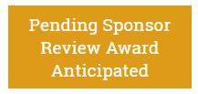
Stages of an Advance Request
The PI must initiate the advance setup, which will route to the Specialist
PI performs the Notify SPO of Grant Status activity in the Funding Proposal workspace.
The Specialist will receive notification of the changed Funding Proposal State and change the status to Pending Sponsor Review Award Anticipated once the Chair and Dean have approved the request.
Once the advance is activated, the active award will be in the Advance Account state.

Slide 8
Removing an Advance Request
The Specialist will initiate the removal of the advance by creating an Award Modification
Once the award modification has been initiated and the Study Staff has updated the budget reconciliation, the Specialist will submit the award for final review and the state will change to Active.

Slide 9
Advance Award Summary
1.
Request Advance - Notify Specialist and submit Ancillary Review
Enter Advance Award information - in Award Smartform
Remove Advance - Enter remaining award information and budget in Modification
2.
3.

Slide 10
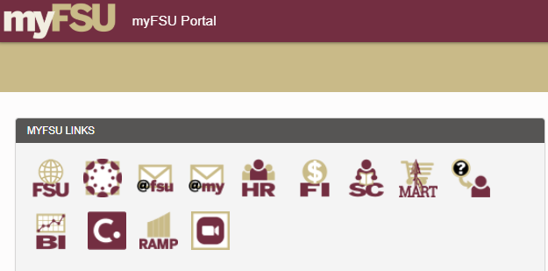
Let’s Go!
Once RAMP Grants goes live, you will access it through your myFSU portal.

Slide 11
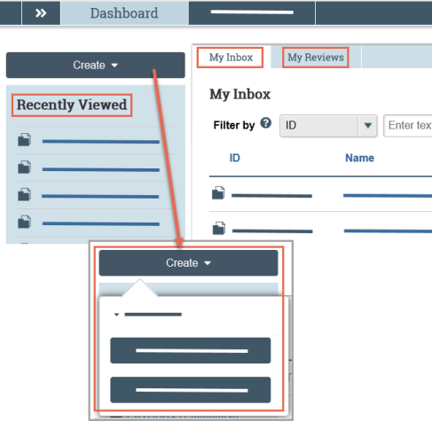
Terminology and Navigation
Getting Around in RAMP
From your Dashboard:
My Inbox: Items that require you to take action.
My Reviews: Items assigned to you to review. These are a subset of the items in My Inbox.
Create menu and buttons: Actions you can perform. The menu will not show if you do not have access to any buttons.
Recently Viewed: The last several items you viewed. Look here for an item you worked on recently.
Notes:
The Dashboard is the Grand Central Station for all of the proposals and awards that are in processing.

Slide 12
Terminology and Navigation
Getting Around in RAMP
To find a specific Proposal or Award, you can pull all of your related proposals and then sort by State.
The double arrows in the top left corner show you a breadcrumb trail.

Slide 13
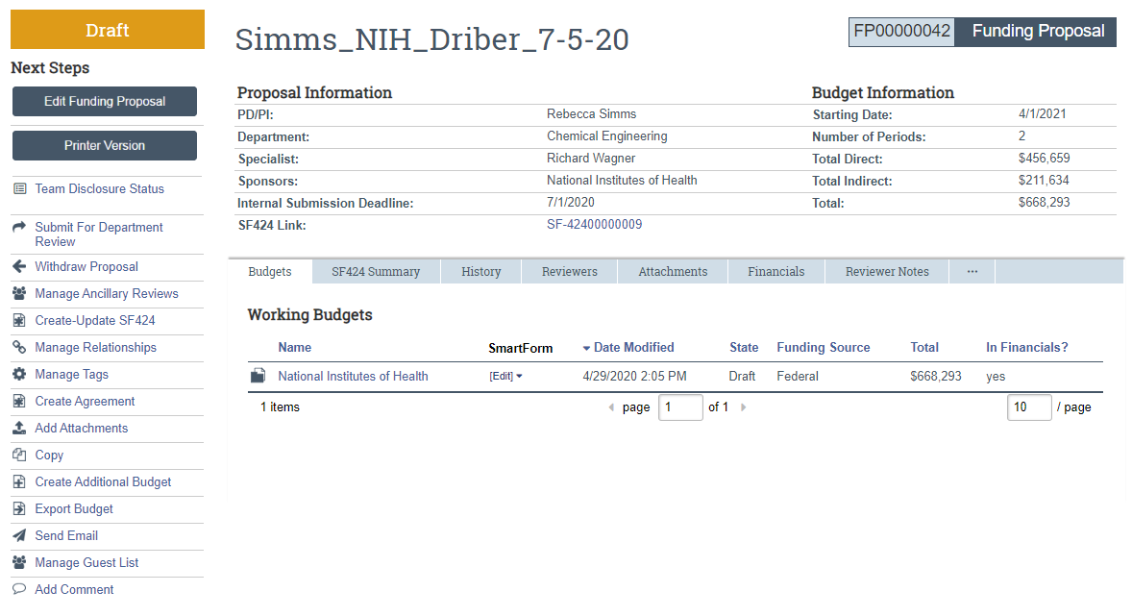
Terminology and Navigation
#1. Workspace
State
Current location
Activities
Notes:
This is your home base for all proposal or award management information and activities.

Slide 14
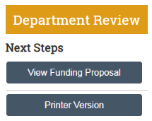
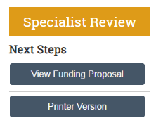
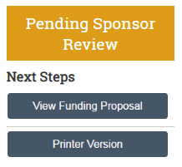
Terminology and Navigation
#2. Smartform
Notes:
The Smartform is the beating heart of your Workspace. The smartform for each workspace is the first action under the State on the left. Depending on the state, you will have the option to either Edit or View the smartform.

Slide 15
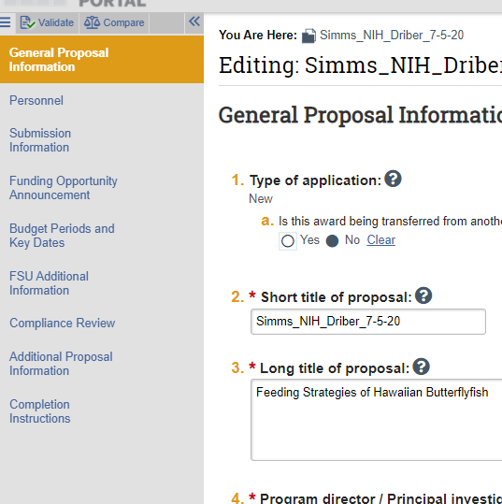
Terminology and Navigation
#2. Smartform
The Smartform contains a list of all the forms or pages on the left. Fields will be editable when you have clicked “Edit” or will show the previously entered data when you have clicked “View.”

Slide 16
Terminology and Navigation
People in RAMP
Specialist – Central office (SRA or FSURF) Research Administrators
Grants Officers
Post-Award Coordinators
Grants Compliance Analysts
Study Staff – PI, Department Research Administrators, other technical staff in the Department. These people are added as administrative personnel with edit rights. They all have the same level of access to the proposals and awards.
Department Reviewers – people designated by your Department to review proposals

Slide 17
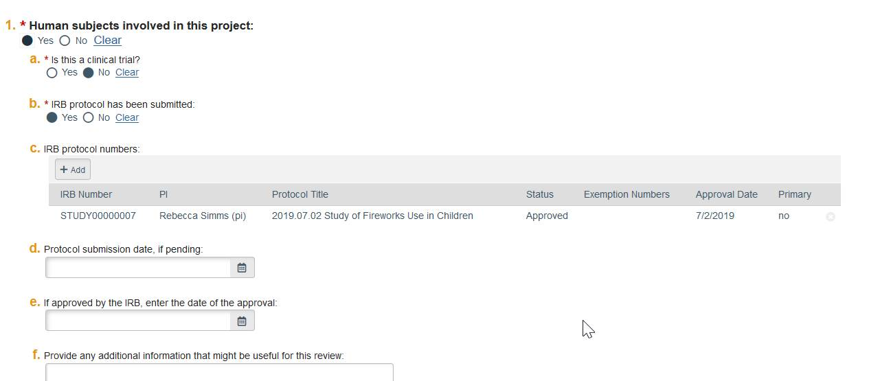
Compliance
IRB Protocols
RAMP Grants will link IRB protocols to Awards.

Slide 18
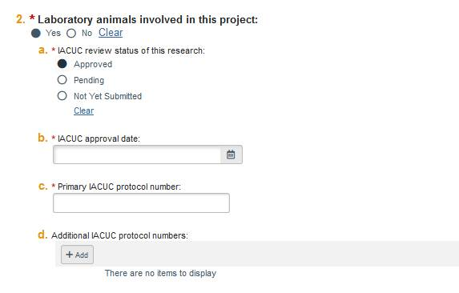
Compliance
IACUC Protocols
IACUC protocols will not be linked, the protocol numbers will be listed.

