Slide 1
Collaborative Proposal & SF 424 Submissions Training
Notes:
Introductions – meeting co-hosted by Rose Driber and Elizabeth Slack, grants officers from the pre-award side of the Sponsored Research Administration

Slide 2
Overview
Notes:
As I’m sure you’re all aware, RAMP is a multi-functional research administration tool that will help us tie all of the various research administration functions together. ACUC, IRB and Agreements are already live, and this training will teach you how to use one of the RAMP Grants features, proposal and SF424 preparation and submission. Kerry Peluso and Angie Rowe have been spearheading the implementation of this system, with Pam Ray leading the Grants module.

Slide 3
Quick Facts
RAMP Grants goes live July 1st.
Proposals will be required to be routed through RAMP July 15th.
RAMP will replace the Proposal Transmittal Form and also house all proposal files (instead of Omni).
All existing awards will be migrated over to and administered in RAMP Grants. New awards will be set up in RAMP, which will integrate with Omni for financial management.

Slide 4
Today’s Agenda
Training Topics and Resource Overview
Terminology and Navigation in RAMP Grants
Walk-through proposal and SF 424 preparation
Fielding and replying to requests for changes
Assign an Ancillary Reviews
Notes:
Please feel free to use the chat feature to ask questions as we move through the presentation.

Slide 5
Training and Resources
RAMP Website: https://ramp.research.fsu.edu/
Training schedule by topic with Zoom meeting links
How-to Guides
FAQ’s
Training topics
Proposal & SF 424 Submissions Training
Budget Entry & Cost Share Training
Collaborative Proposals & SF 424 Submissions Training
Award Review & Completion Training (w/ and w/o advances)
Department Approvers Training
Award Modifications Training
Notes:
The training topics we be addressed in phases. The trainings listed on the website are not the only trainings we will be offering. While everyone is encouraged to attend training topics relevant for their jobs during this cycle, training will continue to be offered after go-live. You can always feel free to contact Angie or Kerry to schedule something specific for an academic department. Show sample of HTG.

Slide 6
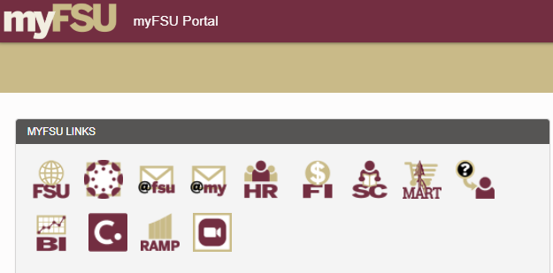
Let’s Go!
Once RAMP Grants goes live, you will access it through your myFSU portal.

Slide 7
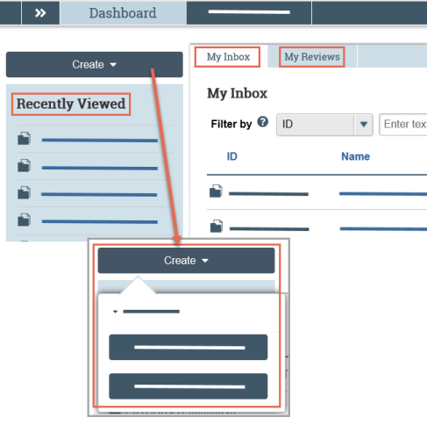
Terminology and Navigation
Getting Around in RAMP
From your Dashboard:
My Inbox: Items that require you to take action.
My Reviews: Items assigned to you to review. These are a subset of the items in My Inbox.
Create menu and buttons: Actions you can perform. The menu will not show if you do not have access to any buttons.
Recently Viewed: The last several items you viewed. Look here for an item you worked on recently.
Notes:
The Dashboard is the Grand Central Station for all of the proposals and awards that are in processing.

Slide 8
Terminology and Navigation
Getting Around in RAMP
To find a specific Proposal or Award, you can pull all of your related proposals and then sort by State.
The double arrows in the top left corner show you a breadcrumb trail.

Slide 9
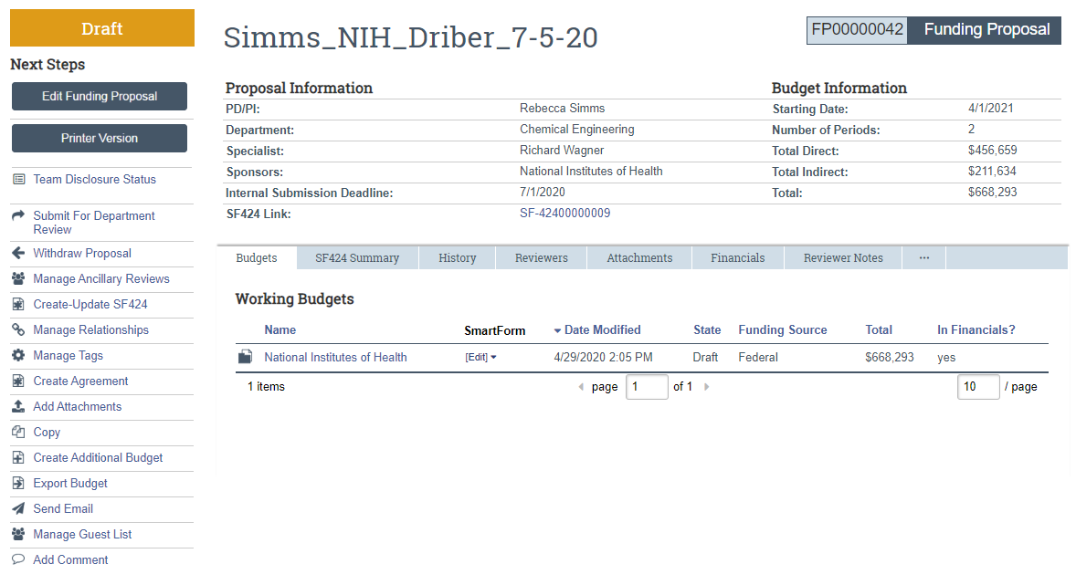
Terminology and Navigation
#1. Workspace
State
Current location
Activities
Notes:
This is your home base for all proposal or award management information and activities.

Slide 10
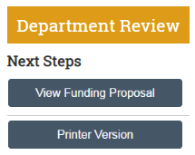
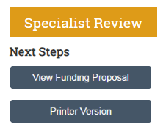
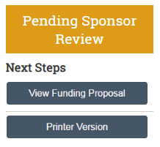
Terminology and Navigation
#2. Smartform
Notes:
The Smartform is the beating heart of your Workspace. The smartform for each workspace is the first action under the State on the left. Depending on the state, you will have the option to either Edit or View the smartform.

Slide 11
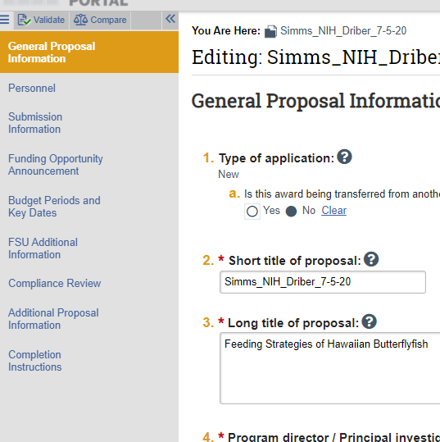
Terminology and Navigation
#2. Smartform
The Smartform contains a list of all the forms or pages on the left. Fields will be editable when you have clicked “Edit” or will show the previously entered data when you have clicked “View.”

Slide 12
Terminology and Navigation
People in RAMP
Specialist – Central office (SRA or FSURF) Research Administrators
Grants Officers
Post-Award Coordinators
Grants Compliance Analysts
Study Staff – PI, Department Research Administrators, other technical staff in the Department. These people are added as administrative personnel with edit rights. They all have the same level of access to the proposals and awards.
Department Reviewers – people designated by your Department to review proposals

